Slide 1
Wabash Capstone
Project Notes 08
By: John Danison

Slide 2
What Did I Say I Would Do This Week?
Follow up with Professor Garcia’s tip about CAN bus protocol.
Potentially begin firmware writing.

Slide 3
What I Have Done This Week
Researched CAN bus protocols.
Not applicable to our situation. See next slide.
Planned out flowchart outline for firmware writing. See slide 5.
Created a simple circuit schematic with all finalized components. See slide 6.
Began pin mapping to aid in firmware development.
Handed off strain gauge sensor duties to Max. More ME sided concepts are needed before I can make further decisions.

Slide 4
Data Acquisition Decisions
Factor | Single Heltec Board | When CAN Bus Makes Sense
Sensor location | All sensors (strain, temp, RH, accel) are right next to the Heltec board | Sensors are spread out across the trailer or vehicle
Wiring distance | Very short (a few inches on a PCB or short leads) | Long cables (up to tens of meters) between nodes
Noise exposure | Low (single enclosure near kingpin) | High EMI areas across the vehicle
Number of microcontrollers | 1 (Heltec handles everything) | Several MCUs each collecting their own data
Data rate | High-speed burst logging to SD card | Low/medium-speed communication between nodes
Reliability needs | Handled easily with good wiring & shielding | Must have fault tolerance & automatic retransmission
Development effort | Simple (SPI/I²C directly on MCU) | More complex (needs CAN transceivers, message IDs, etc.)
Best option here | Custom direct wiring (SPI/I²C/ADC) | CAN Bus if future design adds multiple nodes

Slide 5
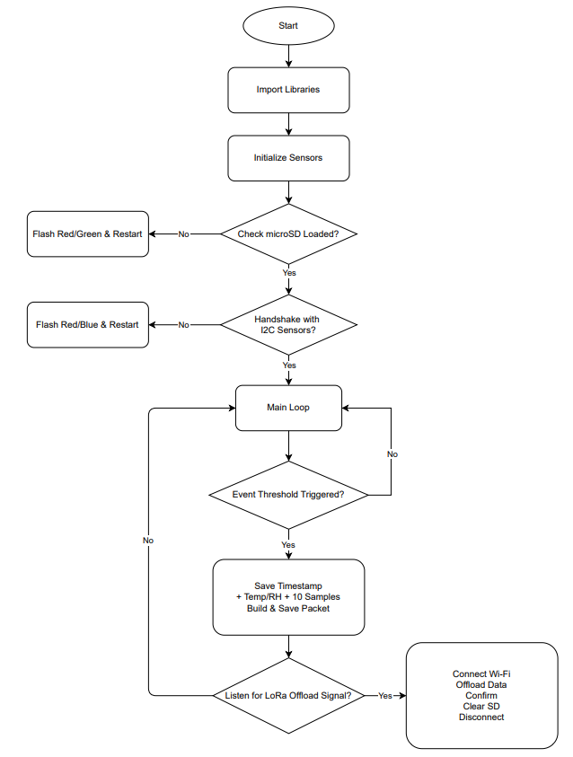
Software – Initial Flowchart Outline

Slide 6
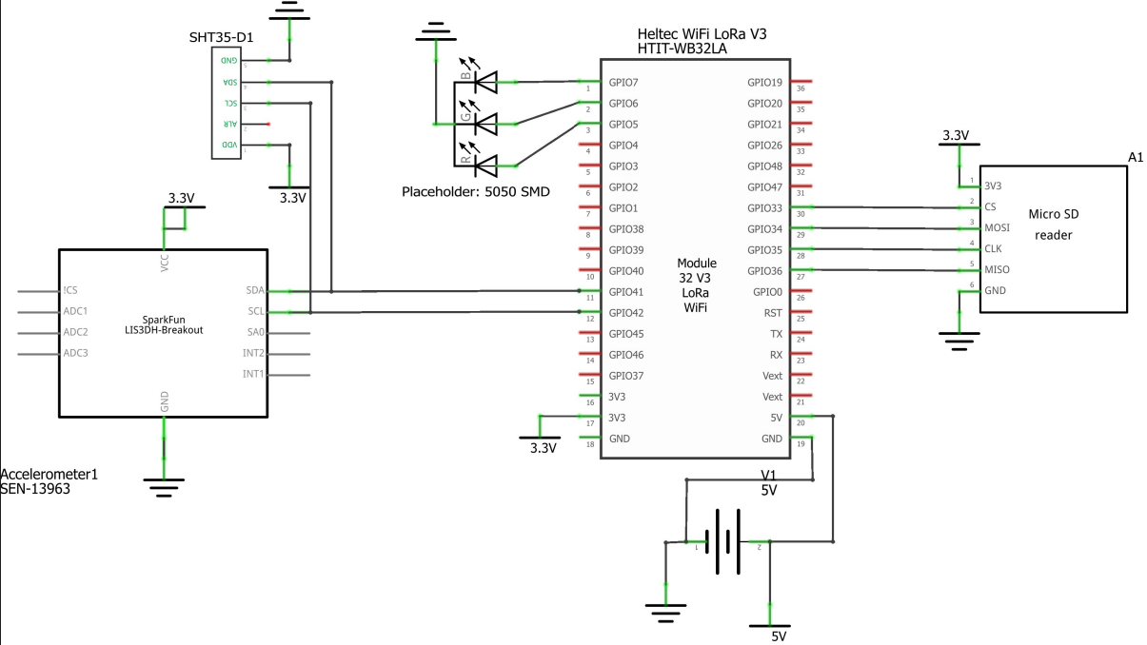
Simple Circuit Schematic

Slide 7



Further Detail About Strain Gauge Meeting
Our group meet with another professor who gave insight into his strain gauge system.
I unfortunately wasn’t able to make it to the meeting. And all the following information is my summarized understanding.
This sparked the conversation that we need to gather more information into how / what forces interact with the trailer causing strain & where.
These concepts are not my strong suit, but they are that of my teammates in particular Max. For the benefit of the group Max is going to take over finding the strain gauge.
This means that I must wait until he makes his selection before I can pick the proper ADC module though I have one in mind.

Slide 8
Did I Do What I Say I Would Do?
I feel mixed about my contributions over the last couple weeks.
We still don’t have a strain gauge, but I handed that responsibility off.
I did start the software development process and create a simple electrical circuit.
I will feel more confident about my contributions once the components arrive and I can start physically testing our ideas and packet structure / design.

Slide 9
Plans For Upcoming Week
High Level
By EOW:
Begin writing firmware outline & find proper libraries for our components.
Find electrical schematic / PCB creating software. Targeting Altium Designer but I am having difficulties.
Create and present slides over data acquisition strategies for Gate 2.5 Presentation.
Have Altium Designer installed or pick new software (KiCad?)

